Slide 1
NoSQL Data Management( Unit-3)
NoSQL is a non-relational database that varies from traditional database system.
NoSQL db is provided for distributed data stores where there is a need for large scale of data storing.
For ex: Google & Facebook are collecting terabytes of data daily for their users such databases do not require fixed schema, avoid join operations, and scale data horizontally.
In a NoSQL db, tables are stored as ASCII files, with each tuple represented by a row & fields separated with tabs. The database is manipulated through shell scripts that can be combined to UNIX pipelines.

Slide 2
As it name suggests, NoSQL does not use SQL as a Query Language.
NoSQL are still in the development stages and are going through a lot of changes.
Software developers who work on databases have a mixed opinion about NoSQL. Some find it is useful , while others point out flaws In it.
Some are uncertain and believe that its just another hyped technology that will eventually vanish due to its immaturity.
This chapter discusses various aspects of NoSQL in detail. It begins by introducing NOSQL and then describes aggregate data models used in it.
This chapter also discusses key-value, column-oriented, document, & graph data models.

Slide 3
Further , it explains the concept of relationships in NoSQL & schema-less dbs.
Apart from this, we will learn about materialized views as well as distributed models. Towards the end , we learn the concept of sharding.
Introdcuction to NoSQL:
There are lot of data storage options available in the market. And yet, many more still coming up as the nature of the data,
platforms,
user-requirement,
architectures, &
processes are constantly changing.

Slide 4
We are living in the era of Big data and are in search of ways handling it.
This has given impetus to , since 2009, the end for creating schema-free dbs that can handle large amounts of data.
These dbs are scalable, enable availability of user, support replication and are distributed & possibly open source. One such db is NoSQL.
Before we develop applications that can interact with NoSQL databases, we should first understand the need for maintaining a separation between Data management & data storage in these dbs.
NoSQL mainly focuses on high performance scalable data storage & provides low-level access to the data layer. This allows data management tasks to be created easily in any programming language.

Slide 5
The below figure shows the interaction of layers in a NoSQL database.
webclient
iphoneAPP
Other UIS
User interface
Logically
Consistent
access
DB
Data
Modelling
and
storage
Data Management Layer
Replication
Storage DB

Slide 6
Why NoSQL:
  Modern NoSQL solutions can tackle applications that require a high degree of scalability,
  Data distribution, And
  continuous availability.
  At the same time, we should also understand that relational dbs have been used for transactional processing in organizations for a very long time.
  RDBMS is supported by several tools and a large trained work force that implements &
  maintains them.
  Hence the need to find an alternative to RDBMS is technical , functional & perhaps financial.

Slide 7
Benefits of NoSQL Databases:
Benefits of NoSQL Dbs challenges against NoSQL Dbs
--------------------------- --------------------------------------
1.Scalable 1. ACID transactions
2. Simple data model 2. Cannot use SQL
3. Streaming/volume 3. EcoSystem/Tools/add-ons
4. Reliability 4. cannot perform searches
5. Schema-less 5. Data loss
6. Rapid-development 6. No referential integrity
7. Flexible as it can handle semi- 7. lack of availability of expertise
structured
8. unstructured, structured data
9. Cheaper than the relational Db
10.Creating a caching layer.
11. Wide data types
12. Uses large binary objects for storing large data
13.Bulk upload
14. Graphs
15. Lower administration 16.Distributed storage
17. Realtime analysis.

Slide 8
Characteristics of NoSQL:
NoSQL databases do not use SQL but some of them have query languages.
When the creators of NoSQL chose the name in NoSQL, then meant to communicate the fact that here is a DB query language that does not follow the principles of RDBMS.
Another important characteristic of NoSQL dbs is that they generally Open source projects.
The term NoSQL is frequently applied to an Open-source phenomenon.
Most NOSQL dbs are driven by the need to run on clusters.

Slide 9
This fact has an effect on their data model as well as their approach to consistency.
For ex: ACID transactions are used to maintain consistency across the whole db, which is also a characteristic of relational DBs.
NoSQL dbs offer a range of options for consistency & distribution.
You are allowed to freely add fields to db records without having to define any changes in the structure because NoSQL operate without Schema.
This comes particularly useful when dealing with non-uniform data and custom fields.

Slide 10
History of NoSQL:
The NoSQL db was invented by an engineer named Carlo strozzi in 1998.
NoSQL ( short for Not only SQL) provides a mechanism for the retrieval & storage of data.
At that time, NoSQL did not provide SQL interface but was relational.
Later when johan oskarsson organized an event on open-source distributed an event on open-source distributed dbs, Eric Evans reintroduced the term NoSQL in 2009.
Most of the NoSQL dbs are non-relational, distributed , and do not follow ACID properties.

Slide 11
When to use NoSQL?
Relational databases have been around for over 25 years, and technology has changed dramatically since then. A relational database uses SQL to perform tasks like updating data in a database or to retrieve data from a database.
Some common relational database management systems that use SQL include Oracle, Db2, and Microsoft SQL Server. Maintaining high-end, commercial relational database management systems are expensive because they require purchasing licenses, trained manpower to manage and tune them, and powerful hardware.

Slide 12
NoSQL enables faster, more agile storage and processing, which means NoSQL databases are generally a better fit for modern, complex applications like e-Commerce sites or mobile applications.
NoSQL database’s horizontal scaling and flexible data model means they can address large volumes of rapidly changing data, making them great for agile development, quick iterations, and frequent code pushes.
In a nutshell, the difference between relational databases and NoSQL databases are performance, availability, and scalability.

Slide 13
Some specific cases when NoSQL databases are a better choice than RDBMS include the following:
When you need to store large amounts of unstructured data with changing schemas .
When you’re using cloud computing and storage.
When you need to develop rapidly.
When a hybrid data environment makes sense.

Slide 14
The most popular NoSQL DBs are MongoDB, Apache Cassandra, Redis, Hbase ,Splunk and Neo4j.
Types of NoSQL data models:
  There are generally 4 types of NoSQL dbs. Each of them have their own attributes & limitations.
  You cannot say a single solution is better among all of them because few dbs are meant to solve specific problems. Following table shows a comparison of various NoSQL data models.
  Data model Performance scalability flexibility Functioning
  Key-value High High High variable
  Column-oriented High High Moderate minimal
  Document High Variable variable variable
  Graph variable Variable variable Graph

Slide 15
1. Key value data model (type 1 mode in NoSQL)
In this the client can get the value for a key, put a value for a key, or delete a key from the data store.
Here the value is a binary large object(BLOB) that is only concerned about data & not what is inside. It is the responsibility of the application to understand what exactly is stored.
BLOB is also scalable because it uses primary key access for the different purposes.
A sample key/value db is shown in figure.

Slide 16
Key/Value
Pros:
  very fast
  very scalable
  simple model
  able to distribute horizontally
Cons:
  - many data structures (objects) can't be easily modeled as key value pairs
Notes:
-> http://chariotsolutions.blogspot.com/2010/01/why-you-need-nosql-in-your-toolbox.html

Slide 17
Figure: A key - value data base
<Key =Customer ID>
<Value= Object>
Customer
Billing Adress
Orders
Order:
ShippingAddress
OrderPyament
OrderItem
Product

Slide 18
NoSQL is Schema-Less Database
Pros:
  - Schema-less data model is richer than key/value pairs
  eventual consistency
  many are distributed
  still provide excellent performance and scalability
Cons:
  - typically no ACID transactions or joins

Slide 19
Common Advantages
Cheap, easy to implement (open source)
Data are replicated to multiple nodes (therefore identical and fault-tolerant) and can be partitioned
  Down nodes easily replaced
  No single point of failure
Easy to distribute
Don't require a schema
Can scale up and down
Relax the data consistency requirement (CAP)
Notes:
-> As the data is written, the latest version is on at least one node. The data is then versioned/replicated to other nodes within the system.
-> Eventually, the same version is on all nodes.

Slide 20
Document data base
Key →<Document>
{ <“customer”:fc111”
“Customer”:
{
“firstname”: ” pramod”
“lastname”: “chakravary”
“company”: “TCS”
“likes”: “Biking”, “Photography”
}
“billing address”
{
“state”: “Telangana”
“city”: “Hyderabad”
“type”: “R”
}
}

Slide 21
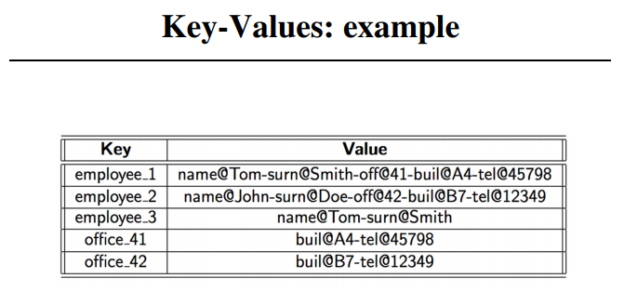

Slide 22
2. Column oriented data model (type 2 model of NoSQL)
Column-oriented DBs are based on columns & every column is considered individually.
the values of a single column are stored continuously.
some examples of column-oriented data models are cassandra, bigdata, simple DB, Hbase.
The data maintained by columns are in the form of column specific files.
in column–oriented data model, the performance on the aggregation queries such as COUNT, SUM, MIN, MAX, AVG is high.

Slide 23
3) Document data model:
There are many type of document databases, such as XML, JSON, BSON etc.
These document databases are self–describing , hierarchical tree data structures that can contain maps, collections, and scalar values.
Document databases mainly stores documents in the value part of the key/value store.
Think about document databases as key/value stores where value is examinable.
For easier transactions from relational dbs, document dbs provide indexing, & searching etc.

Slide 24
4) Graph databases:
  A graph db is a type of db that makes use of graph structures for semantic queries having nodes , edges, & properties to display & store data.
  Graph dbs are mainly used for storing entities & the relationships between these entities.
  An entity nothing but a node with 2 own properties.
  A node can perceived as an instance of object in an application.
  Relations are also known as edges and they can have properties as well.
  Edges are directions & each direction has own significance.
  The graph is organized & the data in it are stored once but interpreted in different aspects based on the relationships.

Slide 25
Whenever we store a graph-like structure in a relational database, it is stored for a single type of relationship.
if we add another relationship to it, it means a lot of schema changes and data movemet . How ever this does not happen in the case of graph databases.
Comparison with normal database and Graph RDBMS:
  In relational databases we model the graph based on traversal. So if the traversal changes, the data will have to change accordingly.
  In graph databases, traversing the join or relationships can be done very quickly.
  Moreover, the relationships between nodes is not calculated at the time of querying but is actually persisted as a relationship.
  The point is that we can have nodes with different types of relationships between them.

Slide 26
This allows to represent relationships between the major domain entries and secondary relationships for category, path or linked list for accessing sorted data.
Moreover , there is no limitation to the number & kind of relationships that can be formed, so relationships can be represented in the same graph database.
Relationships are of permanent importance in graph databases. They help in driving most of the values in these databases.
Relationships can have properties in addition to a start node and an end node. The most important concept of a database is relations among nodes.

Slide 27
Since relationships are their properties & integral to the graph databases, we must invest a lot of time, thought, and design expertise to model the relationships in the domains we are trying to work with.
Additional new relationship types is easy changing existing nodes and their relationships is similar to migrating data, because the major changes must be done on each node and each relationship in your data.
Some examples of popular graph databases are Neo4j, Infinite Graph, & Flock DB.

Slide 28
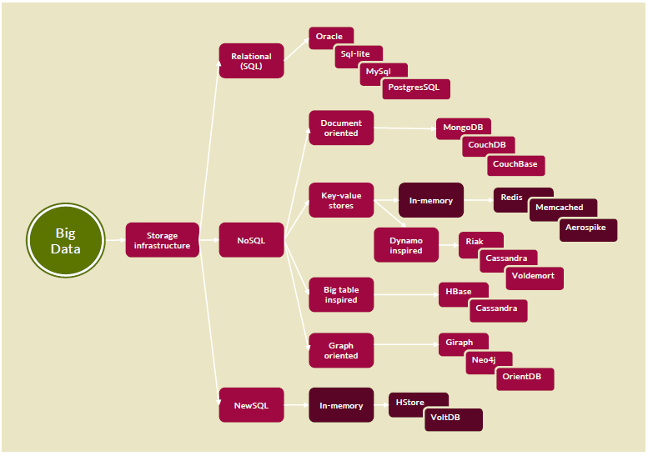

Slide 29
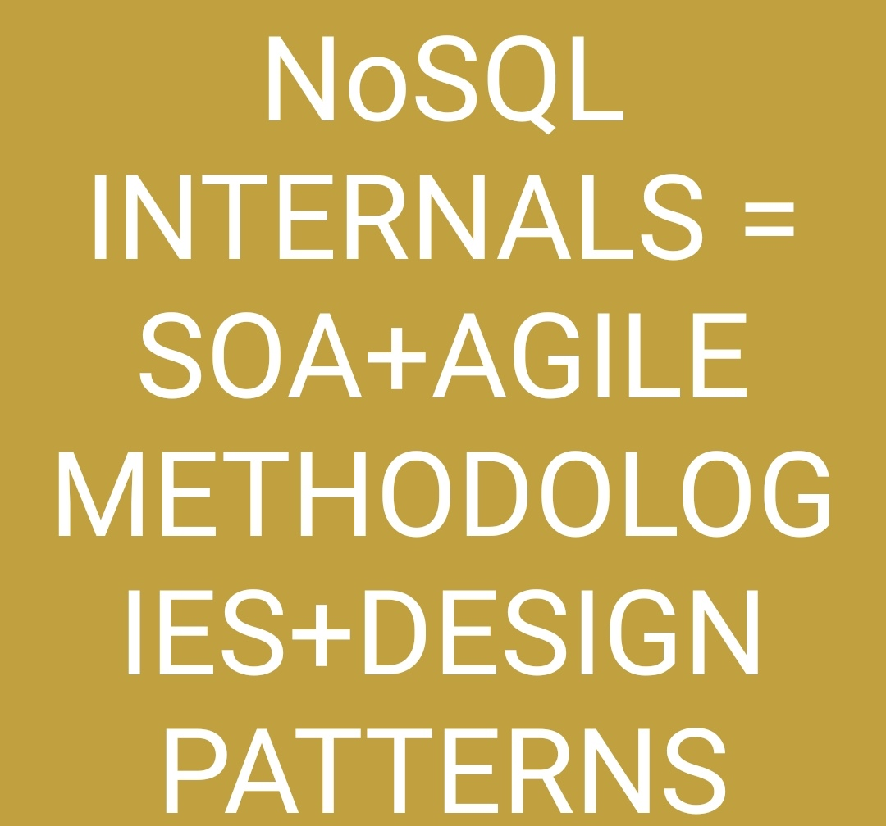

Slide 30
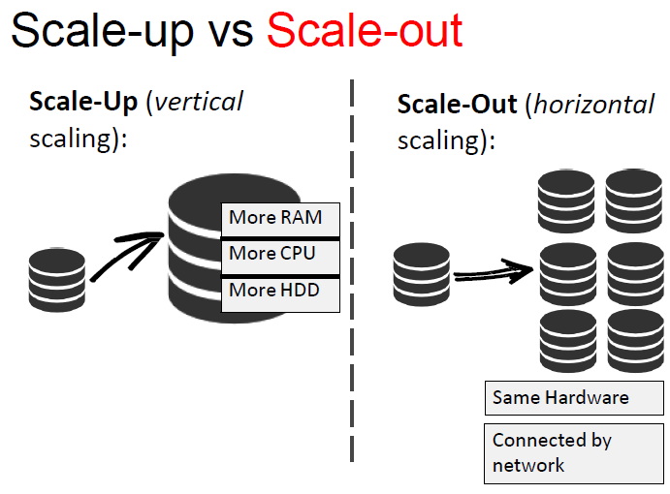
SCALE UP (VERTICAL SCALING) & SCALE OUT (HORIZONTAL SCALING)

Slide 31
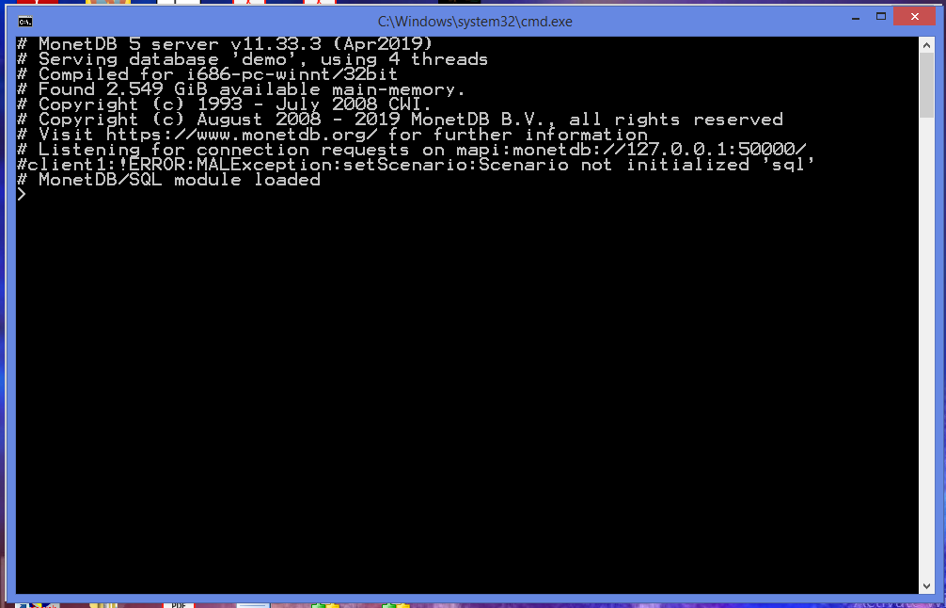
MONETDB (COLUMN – ORIENTED DATABASE) - SERVER

Slide 32
TABLE CREATION IN MONETDB - https://www.monetdb.org/Documentation/UserGuide/Tutorial
CREATE TABLE "voyages" (
"number" integer NOT NULL,
"number_sup" char(1) NOT NULL,
"trip" integer,
"trip_sup" char(1),
"boatname" varchar(50),
"master" varchar(50),
"tonnage" integer,
"type_of_boat" varchar(30),
"built" varchar(15),
"bought" varchar(15),
"hired" varchar(15),
"yard" char(1),
"chamber" char(1),
"departure_date" date,
"departure_harbour" varchar(30),
"cape_arrival" date,
"cape_departure" date,
"cape_call" boolean,
"arrival_date" date,
"arrival_harbour" varchar(30),
"next_voyage" integer,
"particulars" varchar(1285)
);

Slide 33
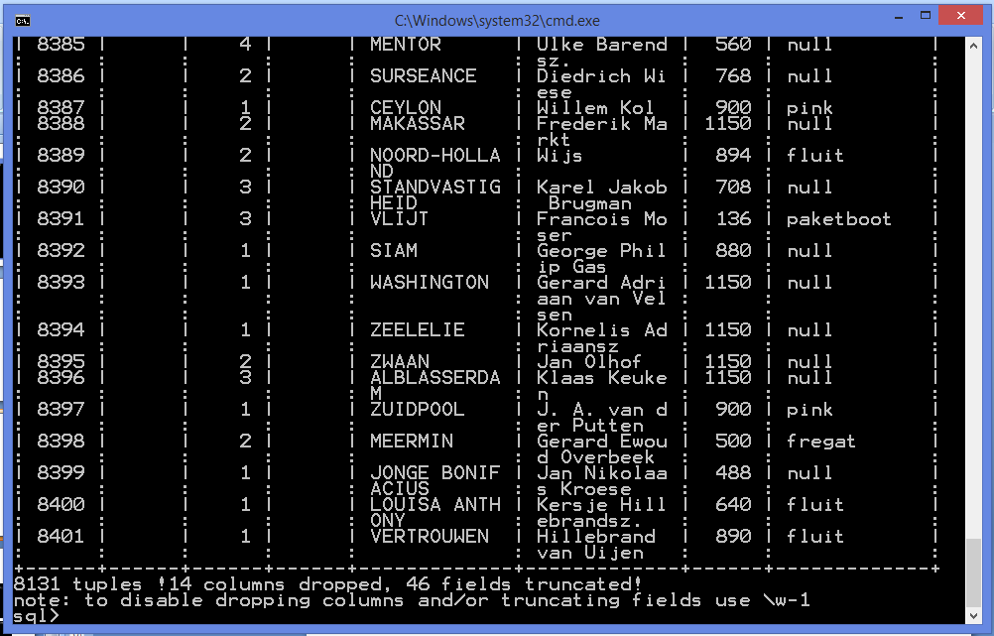

Slide 34
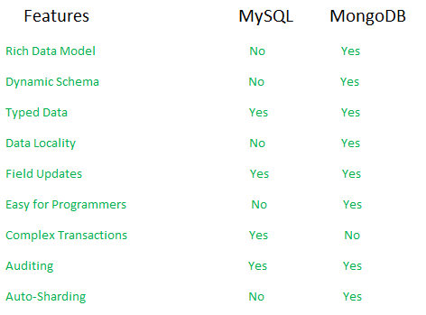
DIFFERENCES BETWEEN SQL VS NOSQL DATABASES

Slide 35
Materialized views
The priority for developers and data administrators in data storage is often on how the database is stored, as opposed to how it is read.
The chosen storage format is usually closely related to the format of the data, requirements for managing data size & data integrity, and
The kind of data store in use.
For example: When using the document model, data is often represented as a series of aggregates, each of which contains all information about an entity.

Slide 36
However, this may have a negative effect on queries.
When a query requires only a sub of the data from some entities, such as a summary of orders of several customers, without all the order details, it needs to extract all of the data for the relevant entities-in order to obtain the required information.
To support efficient querying, a common solution is to generate, in advance, a view that contains the data in a format most suited to generate the required dataset. This view is known as the materialized view.

Slide 37
We can define the materialized view as a pattern that generates prepopulated views of data in environments where the source data is in a format that is not suitable for querying.
In this case generating a suitable query is also difficult or its performance is poor due to the nature of the data or the data store.
Figure shows the materialized views:

Slide 38
Figure: Materialize views
Materialized view(read only)
Application data Is source of truth
application
ItemID,name, total
Shirts 4
trousers 3
Order id, account
A
B
Itemid, Name, stock
Shirts 120
trousers 143

Slide 39
These materialized views, which contain only data required by a query, allow applications to quickly obtain the information they need.
In addition to joining tables or combining data entities, materialized views may include the current values of calculated columns or data items and values specified as part of the query.
A materialized views may even be optimized for just a single query.

Slide 40
An important point to note here is that a materialized view and the data it contains are completely disposable because they can be entirely rebuilt from the source data store.
A materialized view is never updated directly by an application and so it is effectively a specialized cache.
Where there is a cache in the source data while creating view, the view must be updated to the include the new information.
This may occur automatically on an appropriate schedule , or when the system detects a cache in the original data.
In other cases(i.e. if no cache is provided) It may be necessary to regenerate the view manually.

Slide 41
Distribution Models
Aggregate oriented databases allow easy distribution of data.
In such databases, the distribution mechanism is just concerned about the movements of aggregate data and not the related data is stored in the aggregate.
Distribution of data can be done in 2 ways.
Through Sharding.
Through replication.

Slide 42
Sharding: It is used to distribute various types of data across multiple servers. Each server acts as a single source for a subset of data. Sharding is one of the major techniques for data distribution.
Replication: the idea is to copy the data across multiple servers so that each bit of data can be found in multiple places. It is also one of the major techniques fault tolerance.
Master-slave replication, which makes one node the authoritative copy that handles writes, while slave, which are synchronized with the master, handle reads.
Peer-to-peer replication, which allows writes to any node without requiring authorization.

Slide 43
Here the nodes can coordinate with each other to synchronize their copies of the data.
Master replication decreases the chance to update (solve) conflicts(means allows only one subprocess to write) , but peer-to-peer replication avoids loading of all writes onto a single server, causing a single point of failure.
A system may use either or both techniques.
For example: Riak data bases shards the data and also replicates it that is based o the replication factor (discussed in CAP theorem).

Slide 44
CAP Theorem
In case of distributed databases, the 3 important aspects of CAP theorem are
Consistency(C ),
Avaialability(A), and
Partition tolerance (P)
Data is expected to be accurate & available .
In a distributed environment, accuracy depends upon the consistency of the data.
A system is considered available , if the data is available at all points in time.

Slide 45
It is also desirable for the data to be consistent and available even when a network failure renders(make) the database is partitioned into two or more islands(a piece of data surrounded by network ).
A system is considered partition tolerant if processing(still) is continuing in all partitions in the case of a network failure.
In practice , it is hard to achieve all 3 values(C A P’s)
The choice between consistency and availability remains the unavoidability for distributed databases.

Slide 46
CAP theorem states that in any distributed system on can chose only 2 out of the 3 aspects. (i.e. consistency, availability, and partition tolerance).
The third will be determined by those choices.
NoSQL database can be turned to suit ones choice of high consistency, or availability.
For example, for an NoSQL database, there is essentially 3 parameters.
N= Replication factor i.e. the number of replicas created for each piece of data.
R=Minimum number of nodes that should respond to a read request for it to be considered successful.

Slide 47
W = Minimum number of nodes that should respond to a write request before it is considered successful.
Setting the value of R and W very high (R=N and W=N, where N is the total number of nodes) will make the system more consistent.
However it will be slow to report consistency, and thus availability will be low. Since many of them of them may not have yet received the latest copy of the data.
If a network gets partitions, because of a network failure, then one has to tradeoff availability versus consistency.
NoSQL database users often choose availability and partition tolerance over strong consistency.

Slide 48
They argue (users of NoSQL) that short periods of applications misbehavior are less problematic than short periods of unavailability.
Consistency is more expensive in terms of throughput or latency than is availability.
However, HDFS chooses consistency as 3 failed data nodes can potentially render (make/provide) a files blocks completely unavailable.

